Slide 1

Glowzie - Beauty & Self-Care Website

Slide 2
Glowzie
Radiate Confidence:Show your confidence clearly through your face, actions, and attitude.
Like when someone feels good about themselves, they naturally look happy, strong, and proud
Presented by: B.BINDU REDDY
B. ARCHANA
SHALU PANDEY
A. SRINITHYA
Date: 31-7-2025

Slide 3
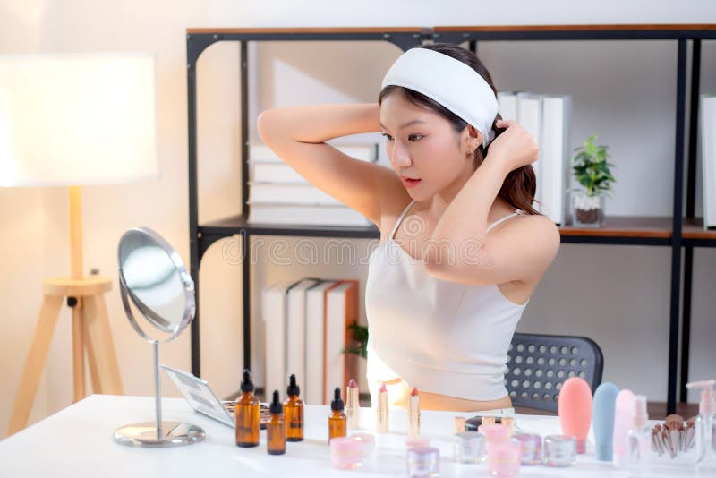
Introduction
"Everyone has the right to look beautiful — and each person is beautiful in their own way.“
Glowzie is a beauty and self-care website.
Offers makeup, skincare, and hair styling.
Helps everyone feel confident and beautiful.

Slide 4

Objectives
Provide easy access to beauty services.
Display portfolio through gallery.
Enable users to contact easily.

Slide 5
Website Features
Home: Welcome and branding.
About: Mission and values.
Services: Makeup, skincare, hair.
Gallery: Showcase work.
Know your Skin: It gives solution for our skin problem
Contact: User inquiry form.

Slide 6
Technologies Used
HTML and CSS
Javascript for interaction
Responsive design
Lightweight and mobile-friendly

Slide 7
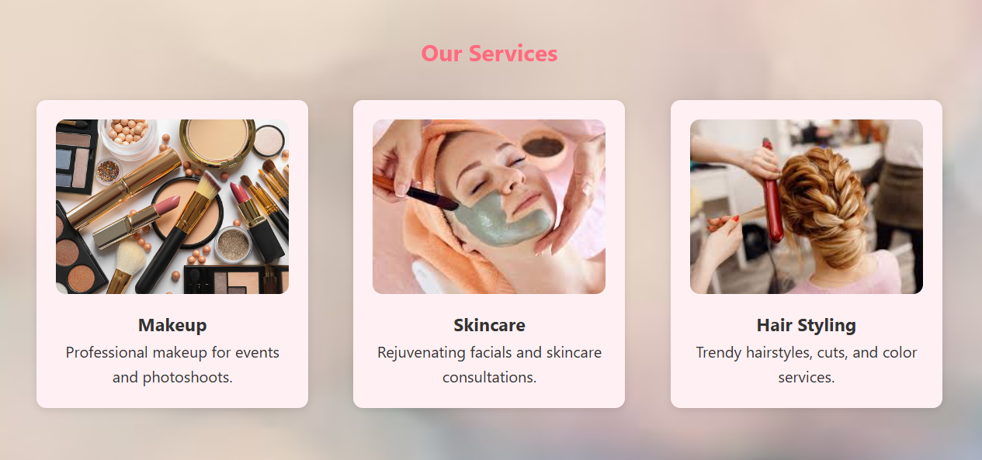
Services Section
Makeup: Events and photoshoots.
Skincare: Facials and consultations.
Hair Styling: Cuts, color, and styles.

Slide 8
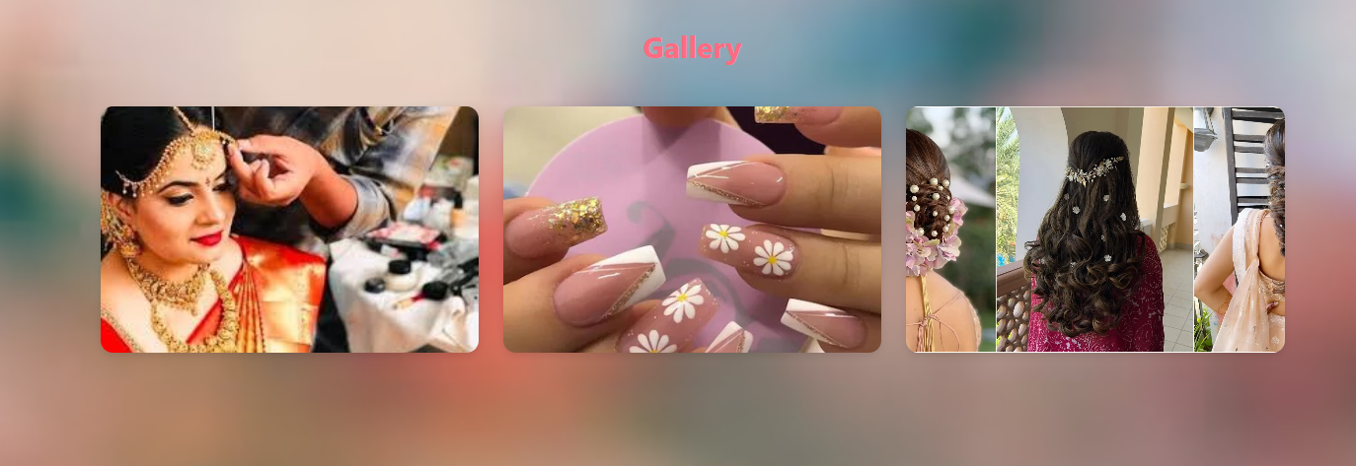
Gallery
Bridal makeup
Nail art
Hairstyling visuals

Slide 9
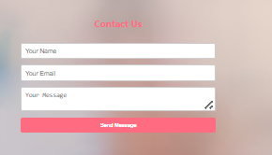
Contact Us
Name, Email, and Message fields
Simple form to get in touch

Slide 10
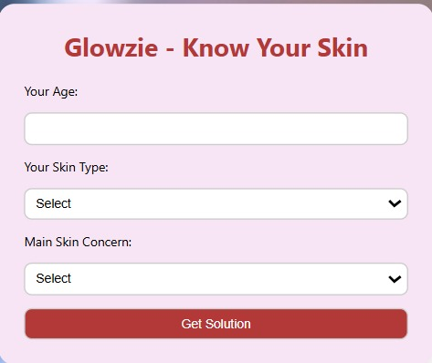
Know your Skin (Tips)
In this the fields included are
Age
Your Skin type : it gives options
like Oily, Dry, Sensitive.
Main Skin Concern: it gives options
like Acne, Aging, Dullness, Redness

Slide 11
Conclusion
Online beauty services with ease
Informative and accessible
Easy to access and contact
“We believe that beauty begins with self-care. Through our project, we aim to support individuals with their journey to feel beautiful in their own skin — because when you feel good, you shine brighter.”

